Slide 1
Learning Intentions (LI) 
Date: 11/5/23
Review what is meant by ‘division of powers’, including responsibilities.
Investigate the concept ‘separation of powers’.

Slide 2
Success Criteria (SC) 
List the three levels of government in Australia.
State three key responsibilities of each level of government.
Outline what is meant by the concept separation of powers.

Slide 3
Review – RIQ -321
Please write the following in your book.
3 Recalls (Remember)
2 Insights (Interesting)
1 Question
You must focus on the topic – ‘Division of Powers’

Slide 4
FEDERAL | STATE
Foreign policy | Schools
Currency | Hospitals
Immigration | Roads and railways
Defence | Police
Weights and measures | Mining and agriculture
Social security | Prisons
Trade and commerce | Public transport
Postal and communication services | Utilities such as electricity and water

Slide 5
The three branches/arms of government 
There are 3 main branches/arms of the Australian government:
The parliament/legislature
The executive
The judiciary

Slide 6
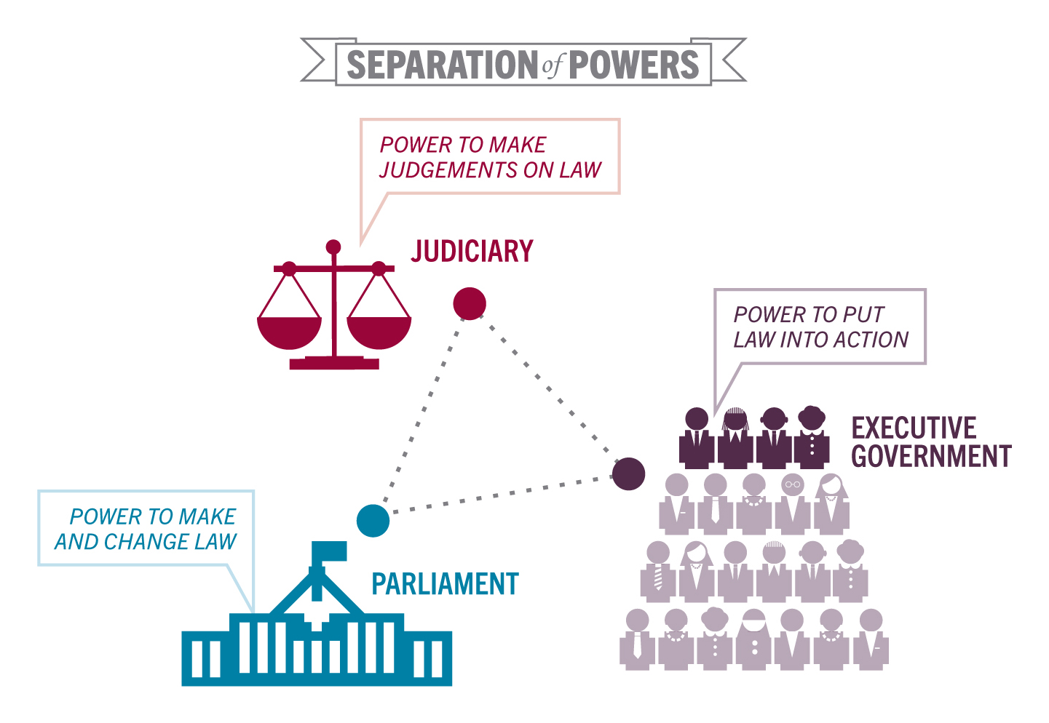

Slide 7
The Parliament/Legislative 
This is the parliament, which has the power to make new laws and to change or repeal existing laws.
It consists of two separate ‘houses’ – the House of Representatives and the Senate – together with the Governor-General as the representative of the King.

Slide 8
The Executive 
This is the branch of government with the responsibility of putting laws into action.
Executive power officially lies with the Governor-General, but is usually exercised by government ministers.

Slide 9
The Judiciary 
This includes the judiciary and the courts.
These are responsible for enforcing the law and settling disputes that might arise under the law.

Slide 10
Success Criteria (SC)
List the three levels of government in Australia.
State three key responsibilities of each level of government.
Outline what is meant by the concept separation of powers.

